Slide 1
Suffix Tree
NAMAN ANAND
200101070
CSE dept

Slide 2
Suffix Tree
What is Suffix Tree ?
Contains keys and position of each suffix
Suffix Tree
Compressed Trie
Contain all the suffixes of a given text

Slide 3
Suffix Tree
Why ?
Aim and Uses
NORMAL TRIE SPACE COMPLEXITY : O(n^2)
PATTERN MATCHING
Suffix Tree
FINDING DISTINCT SUBSTRINGS
Space Complexity : O(n)

Slide 4
Implementation
Code wise

Slide 5
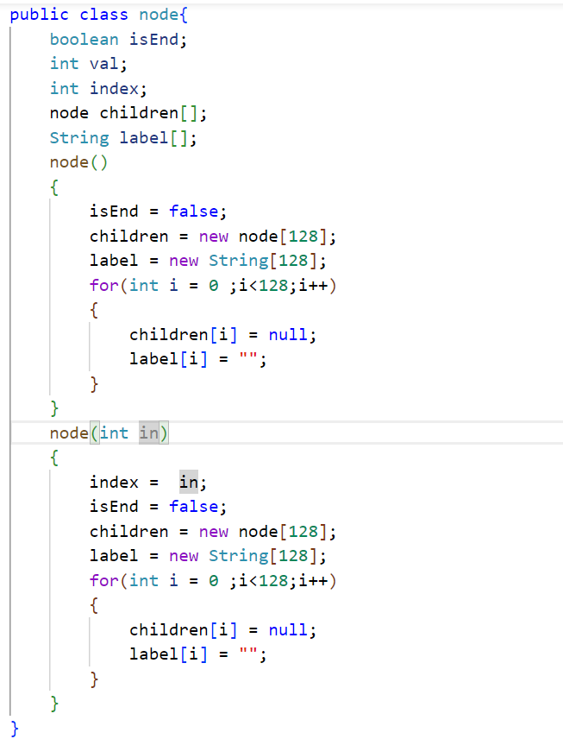
Node Class
Attributes :
isEnd
Val
Index
Children[]
Label[]

Slide 6
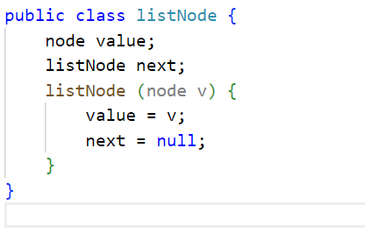
Queue Node
Value
Next

Slide 7
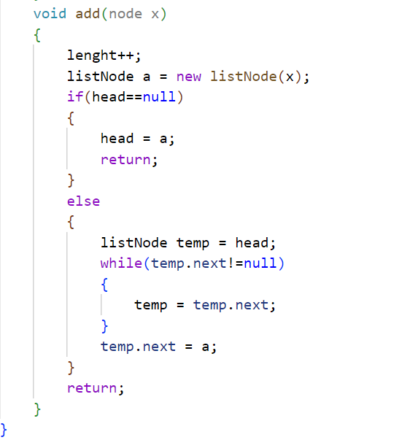
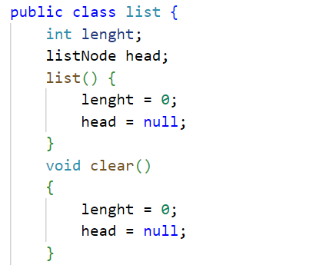
Queue Implementation

Slide 8
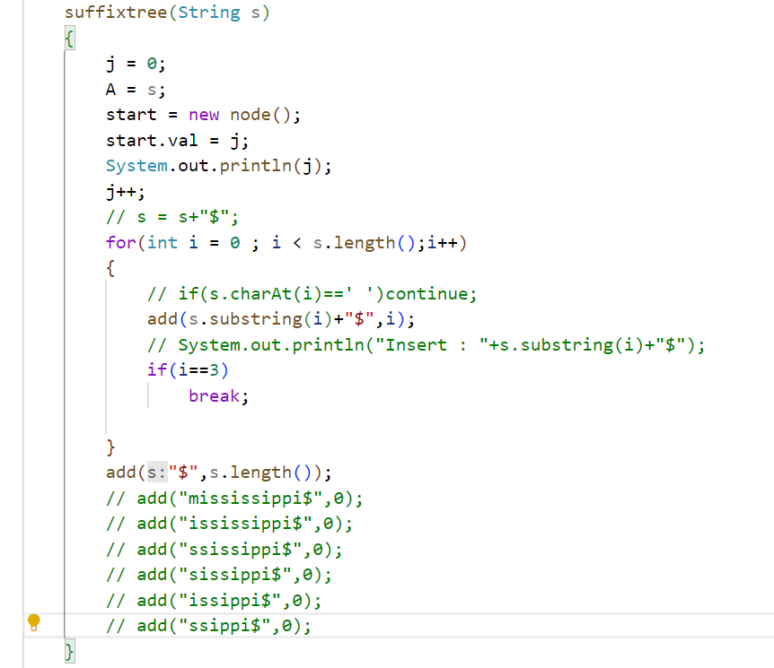
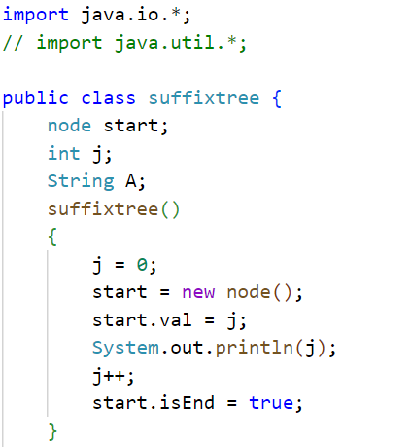
Suffix Tree

Slide 9
Addition of string

Slide 10
Insertion in a suffix tree:
We add all suffix of a string into the suffix tree.
Each edge has a label and each node contain pointers to all character set.
We find if pointer pointing to first character of suffix to be added is null and if it is then we spawn an edge from first character of suffix to a new node, and give label to the edge as the suffix.
If the pointer is not null then we split the nodes corresponding to longest common suffix.

Slide 11
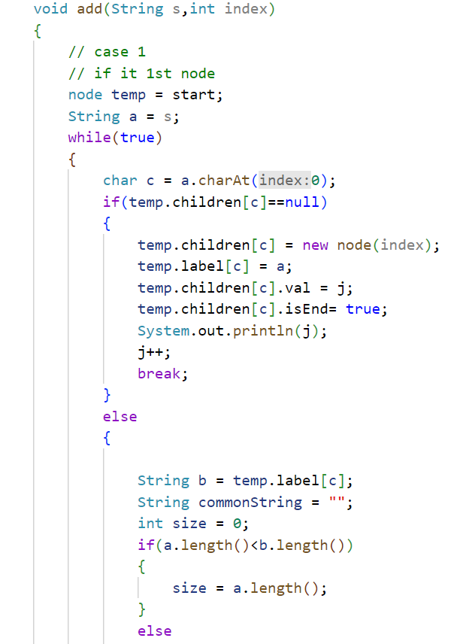
Suffix Tree
Insertion

Slide 12
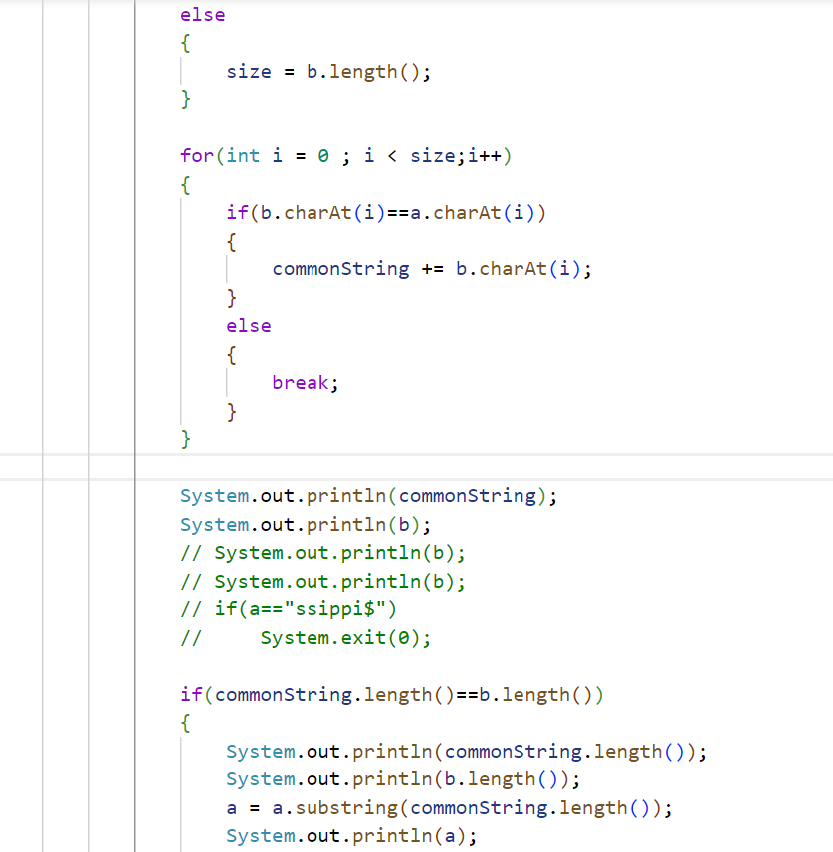
Suffix Tree
Insertion

Slide 13
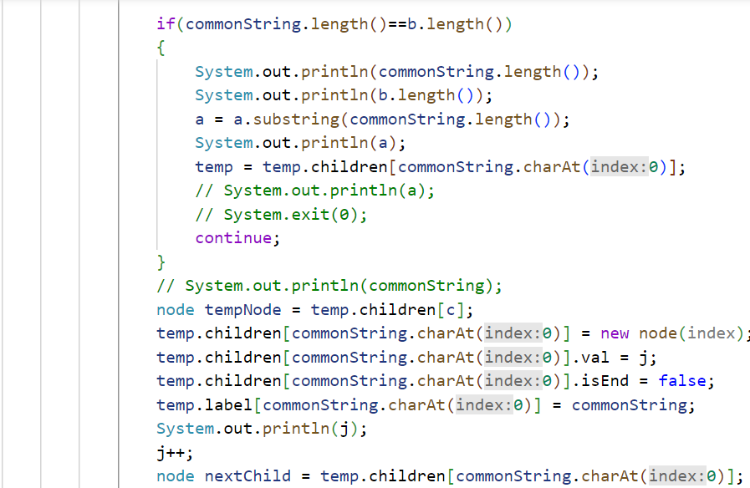
Suffix Tree
Insertion

Slide 14
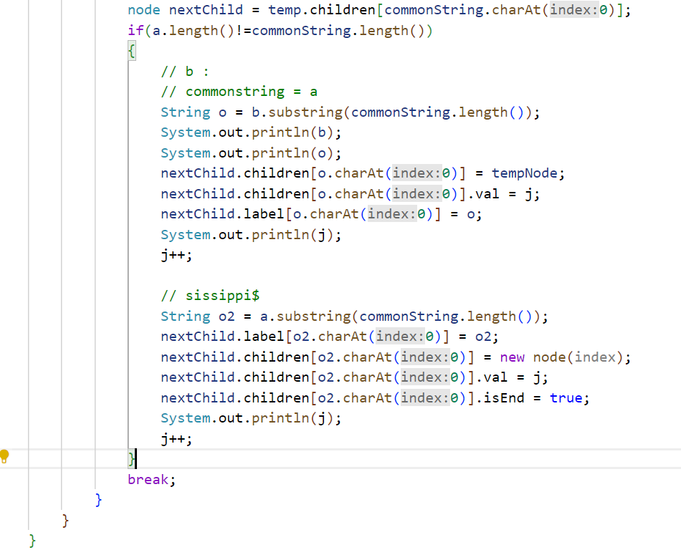
Suffix Tree
Insertion

Slide 15
Searching of String

Slide 16
Search for a substring:
To search for a substring s , we start from root node and follow the pointer path whilst comparing longest common prefix.
We return true if the at some level, the remaining suffix of string to be searched matches with some prefix of the label
Else we return false.

Slide 17
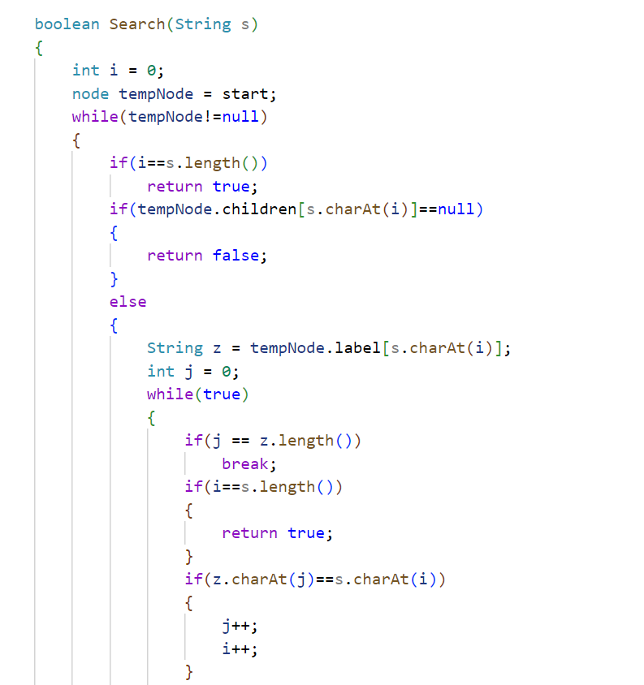
Suffix Tree
Searching of string

Slide 18
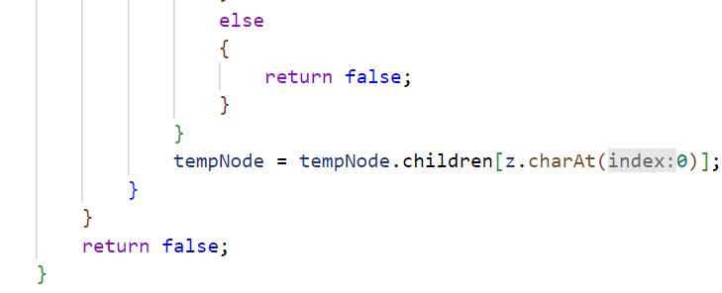
Suffix Tree
Searching of string

Slide 19
Printing of Suffix Tree

Slide 20
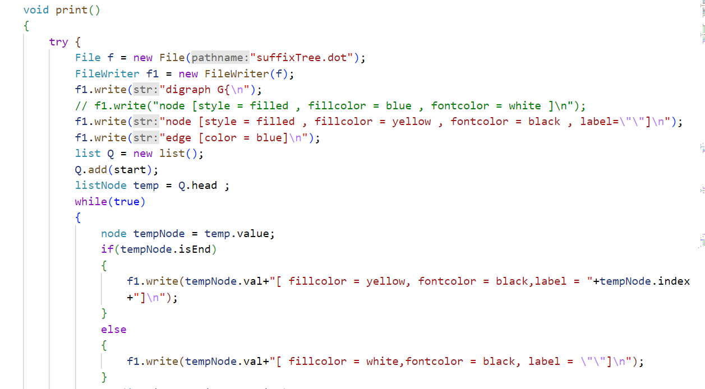
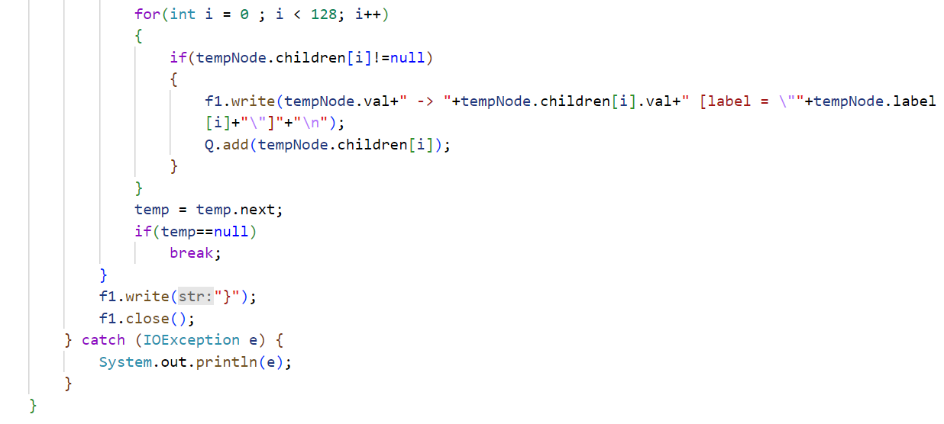
Suffix Tree
Print

Slide 21
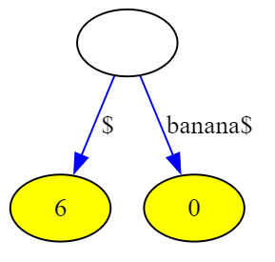
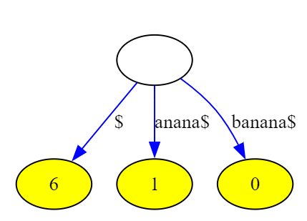
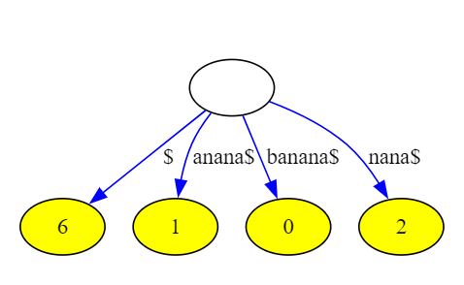
Addition of word “Banana”

Slide 22
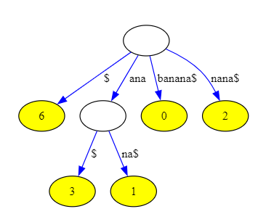
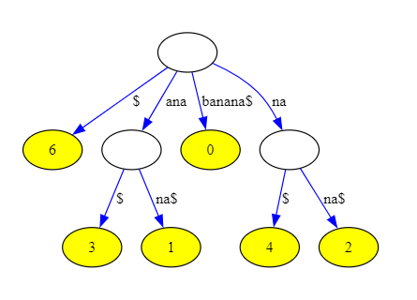
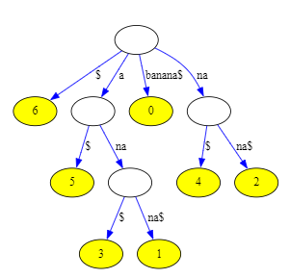

Slide 23
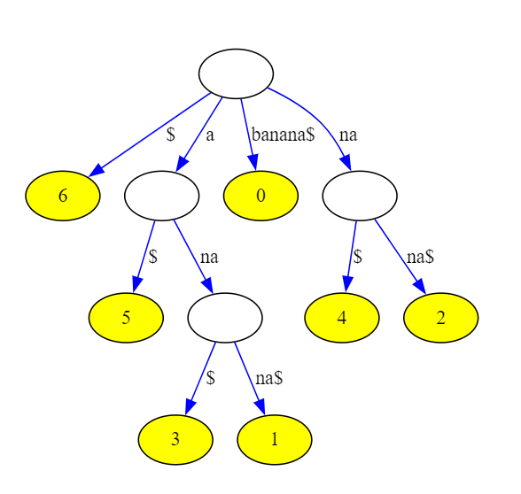
Final Suffix Tree

